Slide 1

DESIGN AND MANUFACTURING MICROSTRIP ANTENNA USING SHORTING CIRCUIT METHOD AT CENTER FREQUENCY OF 435.9 MHz
Ika Rohmatul Aini, Budi Aswoyo
Dept. Of Electrical Engineering
Electronic Engineering Polytechnic Institute of Surabaya

Slide 2






GENERAL STRUCTURE
Introduction
Background Research
Shorting Circuit Method
Simulation
Fabrication and Measuremnet
Conclusion

Slide 3
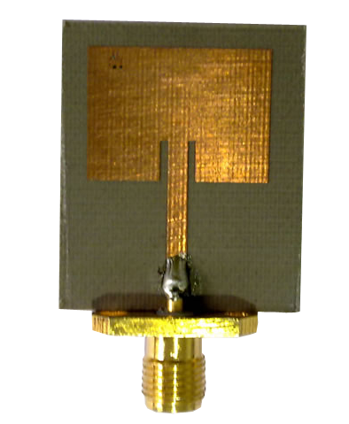
INTRODUCTION
What is microstrip antenna??
Using a circuit board to act as antenna.
It consists of a metal “patch” on top of a grounded dielectric substrate
The patch may be in a variety of shapes, but rectangular and circular are the most common

Slide 4
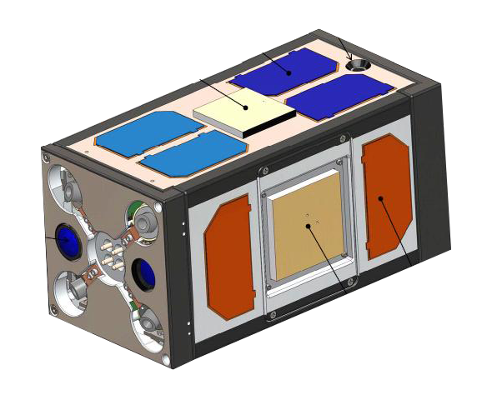

BACKGROUND RESEARCH (1)
Miniaturization and the demand for more compact designs of wireless communication device has been growing.
The antenass are key component which must be small, low profile, and with minimal processing costs
900MGz patch antenna
GPS Antenna
PSSC2 Spacecraft 4,5kg (5x5x10 inch)

Slide 5
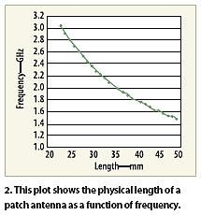
BACKGROUND RESEARCH (2)
The size of the antenass expressed as a function of wavelength.
The lower antennas operating frequency, then the size will be greater.
The size reduction of antennas is needed for practical application

Slide 6


SHORTING CIRCUIT METHOD (1)
It may be completed by wrapping a copper strip around the edge of the antenna or adding shorting pins.
It can realize the same resonant frequency at about half the size of the conventional microstrip antenna.
The main limitation of this technique is narrow bandwidth.
Shorting pin
Coaxial probe
Top view
Side view

Slide 7

SHORTING CIRCUIT METHOD (2)
A chip resistor is placed instead of the shorting pin in order to compensate for the bandwidth reduction.
It is used 1 Ω chip resistor instead of the shorting pin
1Ω chip resistor
Coaxial probe
Top view
Side view

Slide 8
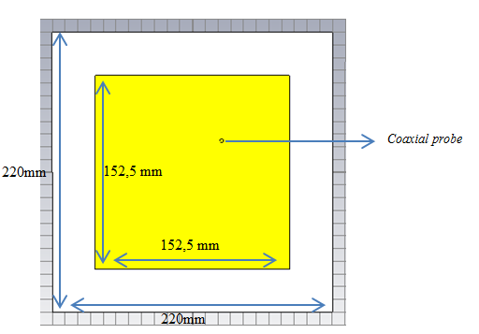


SIMULATION (1)
Conventional Microstrip antenna
Frequency Center = 435,9 MHz
Using FR-4 Substrate ($ε_{reff}$=4.7)
$Lenght=Width$
$Width=\frac{c}{2f_{0}\sqrt{ε_{reff}}}$

Slide 9
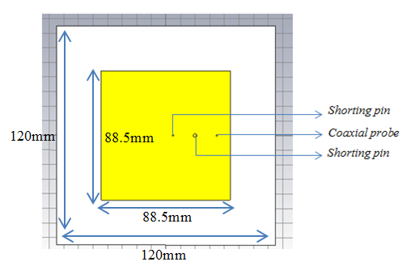
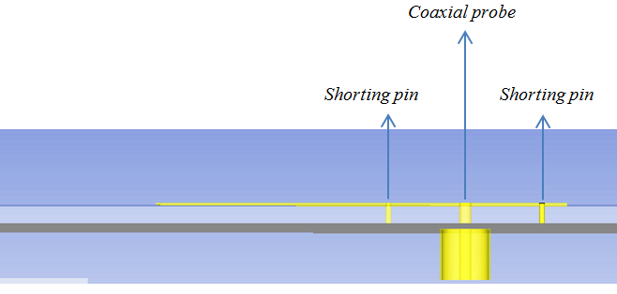

SIMULATION (2)
By adding shorting pin
Frequency Center = 435,9 MHz
Using FR-4 Substrate ($ε_{reff}$=4.7)
Top view
Side view

Slide 10
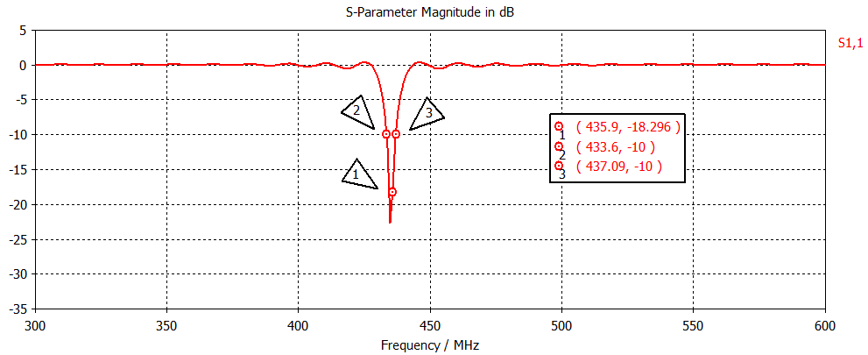

SIMULATION (3)
S11 Parameter by adding shorting pin
Frequency Center = 435,9 MHz
Using FR-4 Substrate ($ε_{reff}$=4.7)
Bandwidth = 3,43MHz

Slide 11
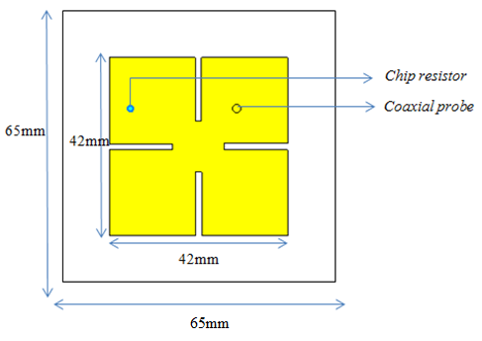
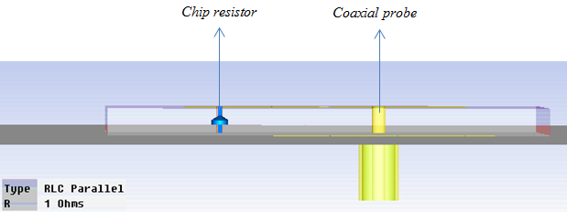

SIMULATION (4)
By adding 1Ω chip resistor
Frequency Center = 435,9 MHz
Using FR-4 Substrate ($ε_{reff}$=4.7)
Top view
Side view

Slide 12
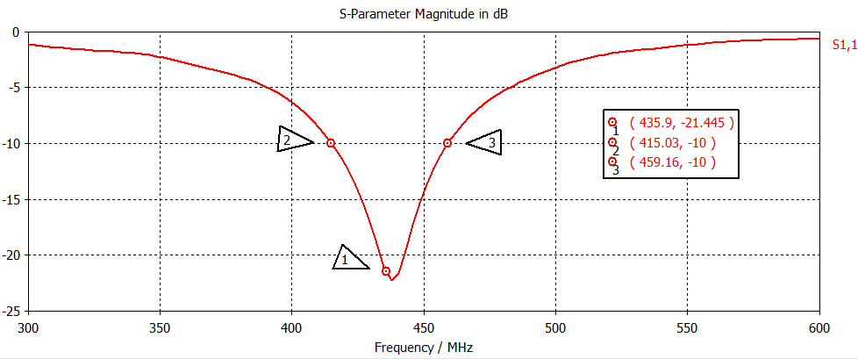
SIMULATION (5)
S11 parameter microstrip antenna by adding 1Ω chip resistor
Bandwidth = 44,13 MHz

Slide 13
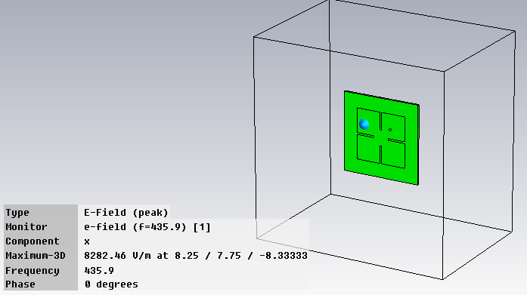
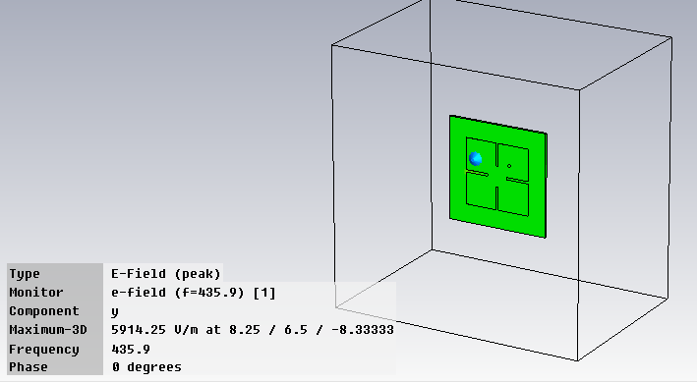

SIMULATION (6)
Axial ratio microstrip antenna by adding 1Ω chip resistor
$$Axial ratio=20log \frac{8282,46}{5914,25}$$
$=2,9dB$

Slide 14
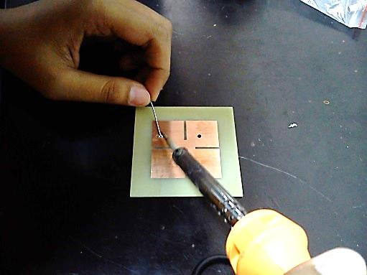
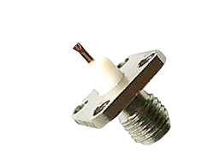
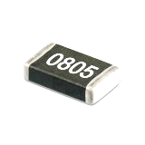
FABRICATION (1)
(a)
(b)
(c)
chip resistor 1 Ohm (b) coaxial SMA female flange 50 Ohm connector
(c) Microstrip antenna

Slide 15
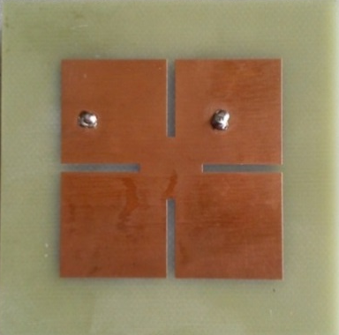

FABRICATION (2)
Microstrip antenna by adding 1Ω chip resistor
65 mm
65 mm
Top view
Back view

Slide 16
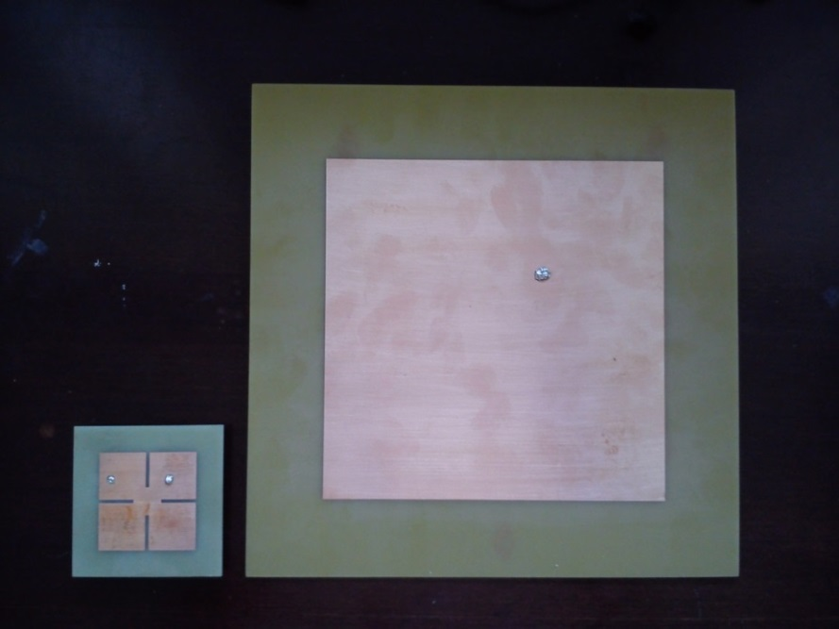
FABRICATION (3)
Comparison between conventional and 1Ω chip resistor microstrip antenna
220 mm
220 mm
65 mm
65 mm
By adding 1Ω chip resistor
Conventional

Slide 17
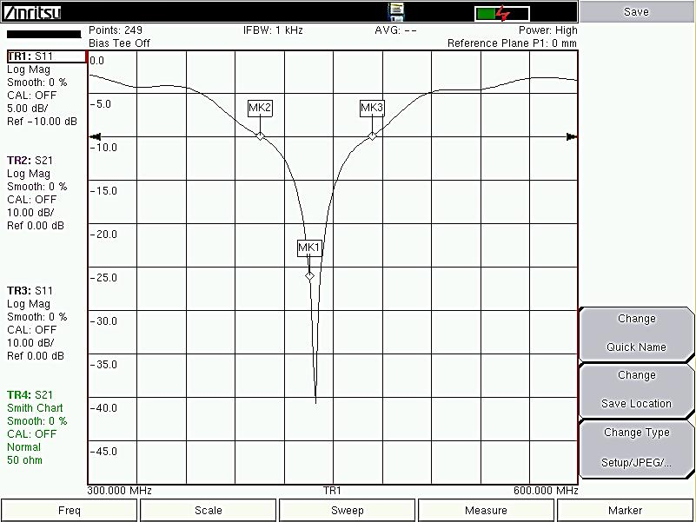
Measurement
S11 Parameter microstrip antenna with 1Ω Chip resistor

Slide 18
Conclusion
Shorting circuit method is combined with the addition of chip resistor instead of the shorting pin in order to enlarge the obtained bandwidth.
The resulting bandwidth of microstrip antenna with chip resistor is 69.379 MHz.
Circular polarization has been achieved.
The total size reduction of the microstrip antenna with chip resistor is equal to 338.46%.

